Slide 1
Example Class 3
Wong Chu Feng, Rivaldo Billy

Slide 2

(1) Recursive definition
$P\left(C\right)=0; when C=0 or n=0;$
$P\left(C\right)=\left\{max⁡P\left(C\right), P\left(C\right)−weight\left[i\right]+P\left(i\right)\right\}$

Slide 3
(2) Subproblem graph
P(14)
P(10)
P(8)
P(6)
P(4)
P(2)
P(0)

Slide 4
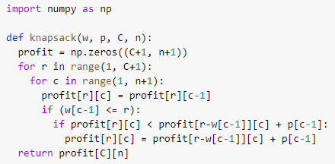
(3) DP-algorithm for max profit (Bottom-up)

Slide 5
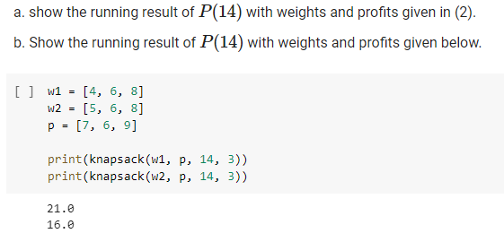
(4) Result of P(14)

